Slide 1
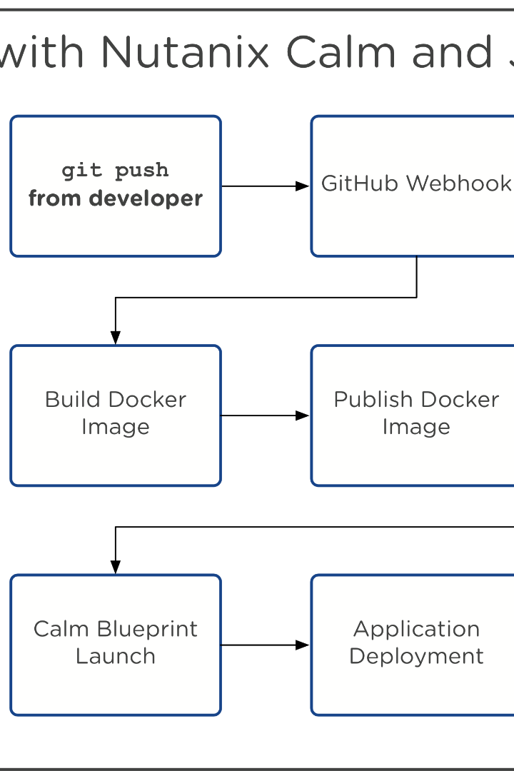

How to Chain Jobs in Jenkins
Welcome to the ultimate guide on how to chain jobs in Jenkins. We'll walk you through everything you need to know about this powerful tool.
by Charanjit Singh

Slide 2
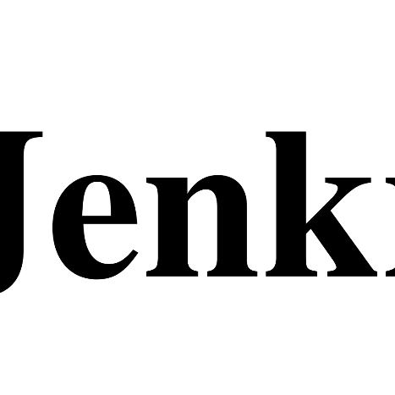
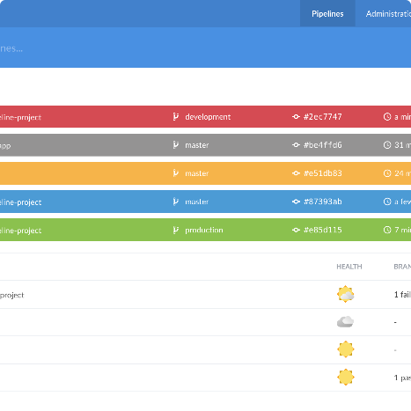
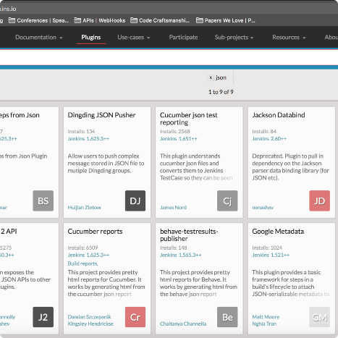
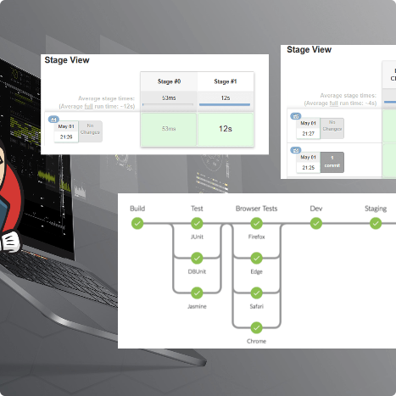
Overview of Jenkins
What is Jenkins?
Dashboard
Plugins
Pipelines
Jenkins is a popular open-source tool that allows developers to build, test, and deploy their software quickly and efficiently.
The Jenkins dashboard provides an at-a-glance view of all your projects and their build status, allowing you to quickly identify and address any issues.
Jenkins has a vast library of plugins that can be used to extend its functionality, from integrating with other tools to adding new steps to your build process.
Jenkins pipelines allow you to visualize your entire build process and ensure that each step is executed correctly.

Slide 3

Understanding Job Chaining
What is Job Chaining?
Job chaining in Jenkins refers to the process of running multiple Jenkins jobs in sequence.
Why Use Job Chaining?
Job chaining allows you to break up your build process into smaller, more manageable pieces. This makes it easier to debug and maintain your build process.
How Does Job Chaining Work?
Jenkins allows you to define triggers between jobs, so that when one job finishes, the next one in the chain is automatically started.

Slide 4
Creating a Chain of Jobs in Jenkins
Step 1: Create Your Jobs
Step 2: Define Triggers
Step 3: Configure Your Jobs
The first step in job chaining is to create the individual jobs that will make up your build process.
Once you have your jobs created, you'll need to define the triggers that define the order in which they should run.
Finally, you'll need to configure each job to perform its specific task. This might include building your code, running unit tests, and deploying your application.

Slide 5
Advanced Chaining Techniques
1
2
3
Parallel Job Execution
Conditional Execution
Error Handling
Jenkins allows you to execute multiple jobs in parallel, which can significantly speed up your build process.
You can set up Jenkins to only run a job if certain conditions are met, such as if a specific file has been updated in your source code repository.
In complex build processes, it's important to have robust error handling in place to ensure that your builds don't fail unexpectedly. Jenkins provides a number of tools for doing this, such as retries and failure notifications.

Slide 6

Best Practices for Job Chaining
1
Keep It Simple
2
Use Git Hooks
Job chaining can quickly become complicated, so it's important to keep your build process as simple as possible.
You can use Git hooks to trigger Jenkins builds automatically whenever you push changes to your repository.
3
Always Review Logs
4
Regularly Update Your Jobs
Jenkins logs can provide valuable insights into your build process and help you identify issues quickly. Review them regularly to ensure everything is running smoothly.
As your application changes, you'll need to update your build process. Regularly reviewing and updating your Jenkins jobs will help ensure that everything remains in sync.

Slide 7
Conclusion
Why Job Chaining is Important
Next Steps
Job chaining is a powerful tool that can help you automate your build process and improve the quality of your software.
Now that you're familiar with the basics of job chaining in Jenkins, why not take things to the next level by exploring some of the more advanced techniques we covered in this tutorial?

